Slide 1
GUNSMOKE MINES
Development Log
Bruno Mirone · FGCT4017 Fundamentals of Games Design · BA (Hons) Game Design, Level 4, UCA
Built in Unreal Engine 5.6 using Blueprints only

Slide 2
The game
A top-down wild-west dungeon crawler: shoot bandits, collect keys, open chests, reach checkpoints, kill the boss.
17
4
0
1
assets
days to build
lines of code
continuous level
Player
WASD movement, aims at the mouse, dashes with brief invulnerability
Combat
One hitscan weapon; a shared health component handles all damage
Enemies
Bandits chase and attack; the boss is the same logic with heavier numbers
Loop
Keys open chests, chests give powerups, checkpoints save your place

Slide 3
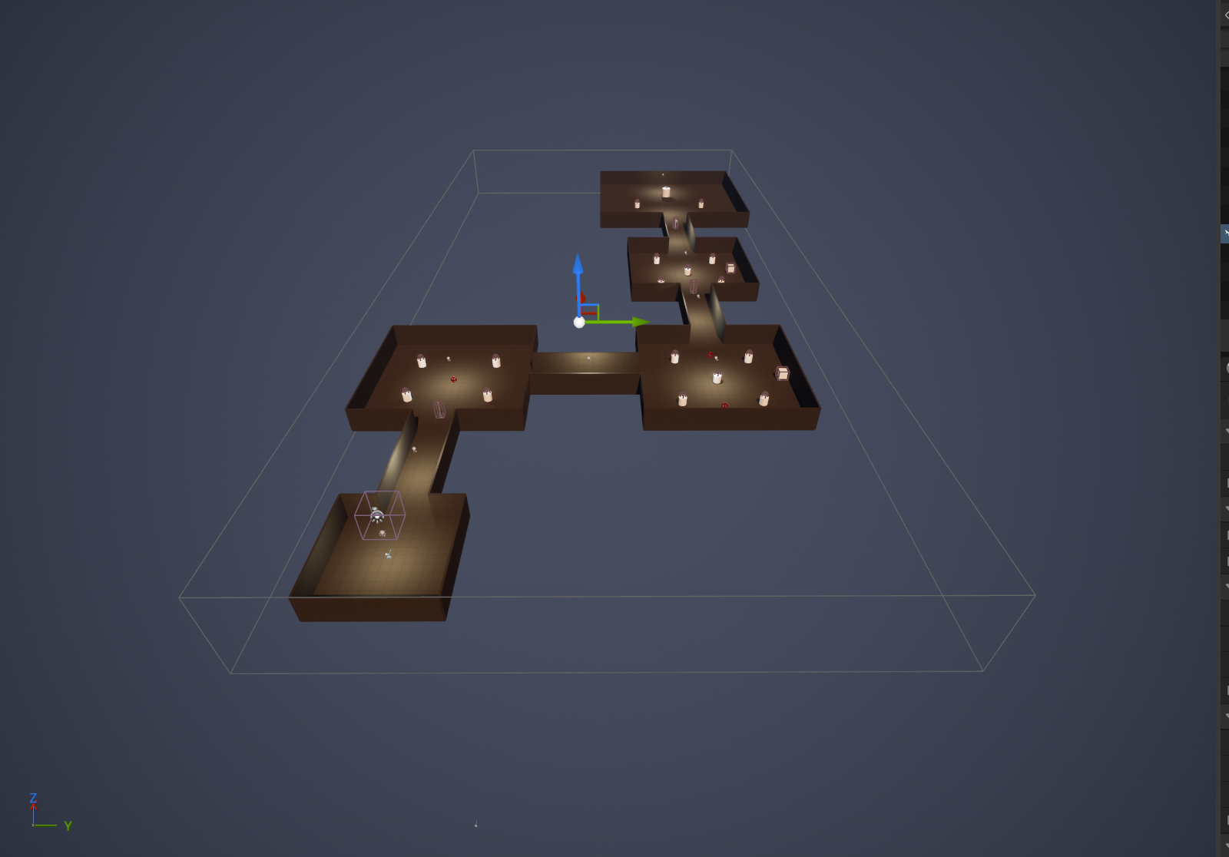
The level
The mine is one continuous level of connected rooms and corridors, blocked out from cubes.
L_Mine, top-down view

Slide 4
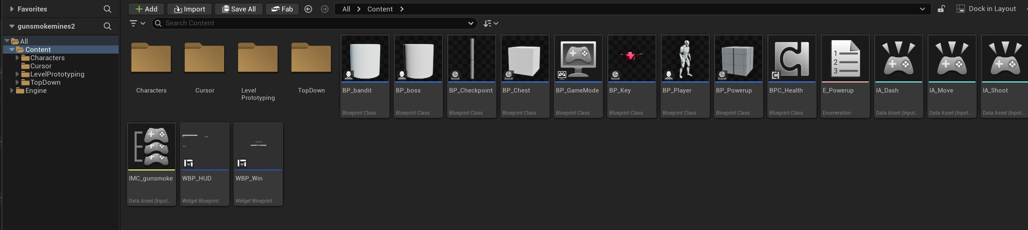
Everything in the project
Seventeen assets in total: eight Blueprints, a shared component, two widgets, the input set and one level.
Content Browser

Slide 5
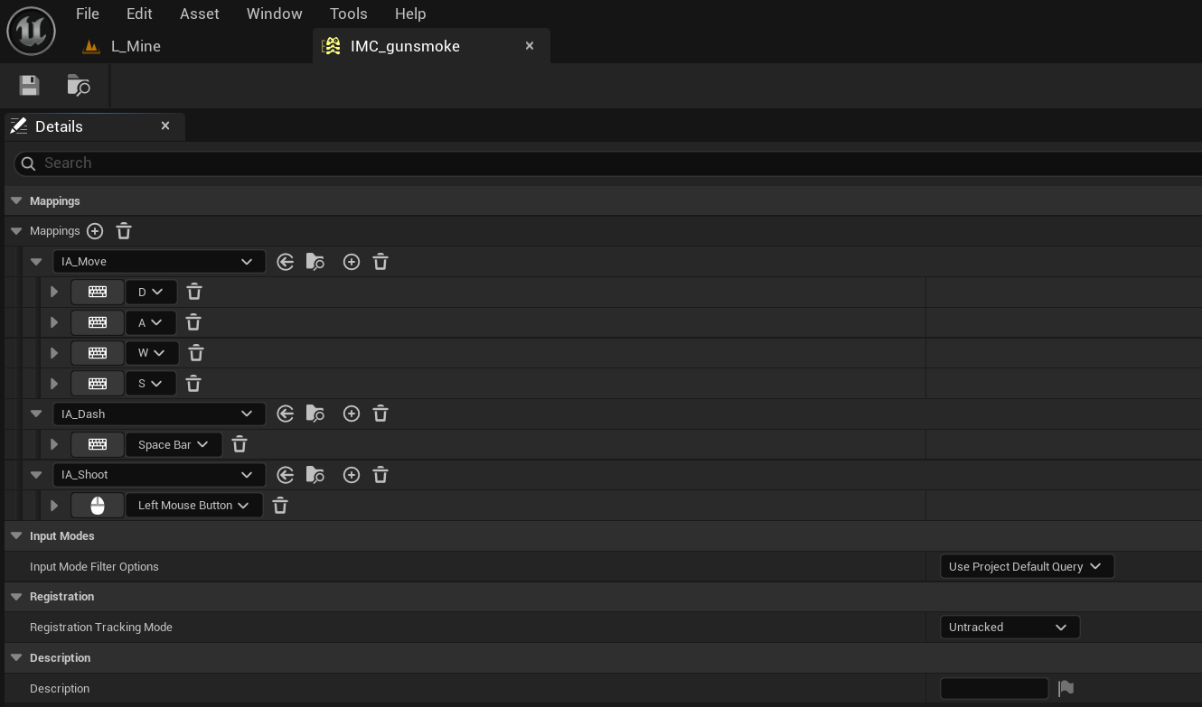
Input
Enhanced Input maps WASD, Space and the left mouse button through a single mapping context.
IMC_gunsmoke

Slide 6
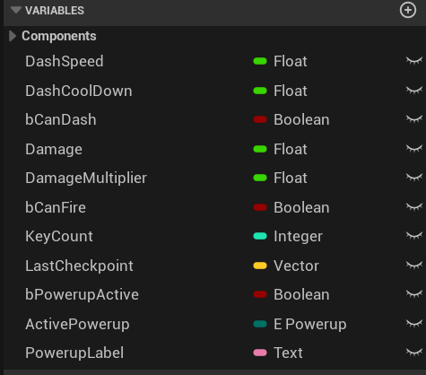
Player variables
Every tunable value lives on the player as a variable, so balancing means editing numbers rather than rewiring.
BP_Player, variables

Slide 7
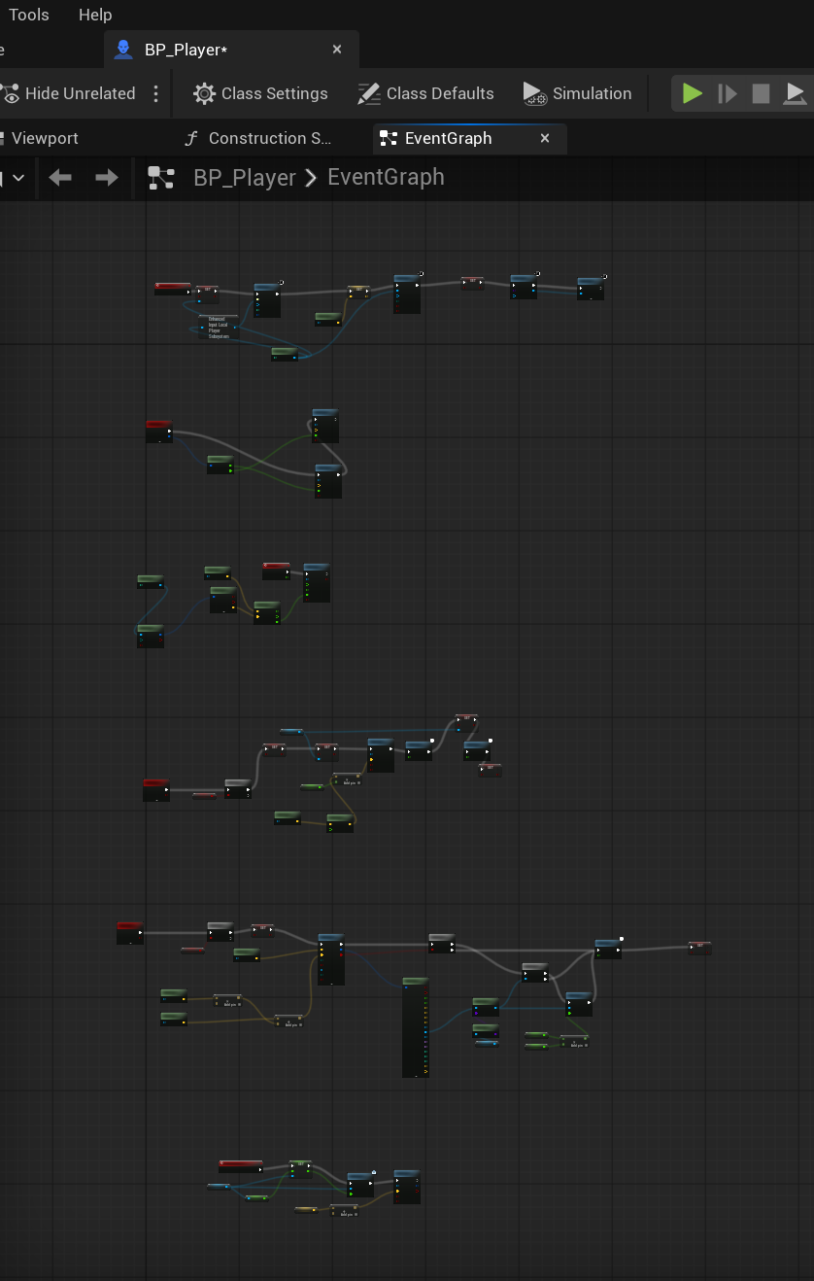
The player
One graph handles movement, mouse aim, the dash, shooting and respawning at the last checkpoint.
BP_Player, Event Graph

Slide 8
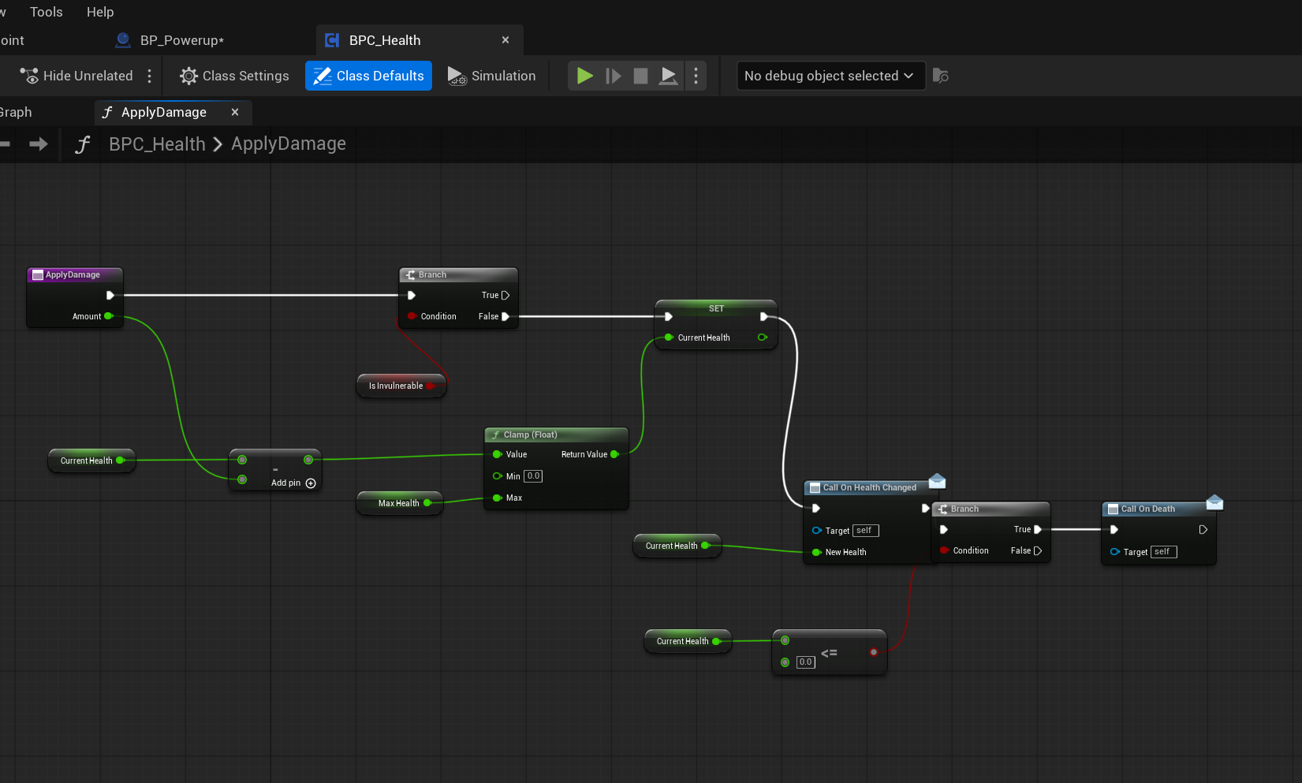
Shared health
A single reusable component handles damage, death and health changes for the player, the bandits and the boss.
BPC_Health, ApplyDamage

Slide 9
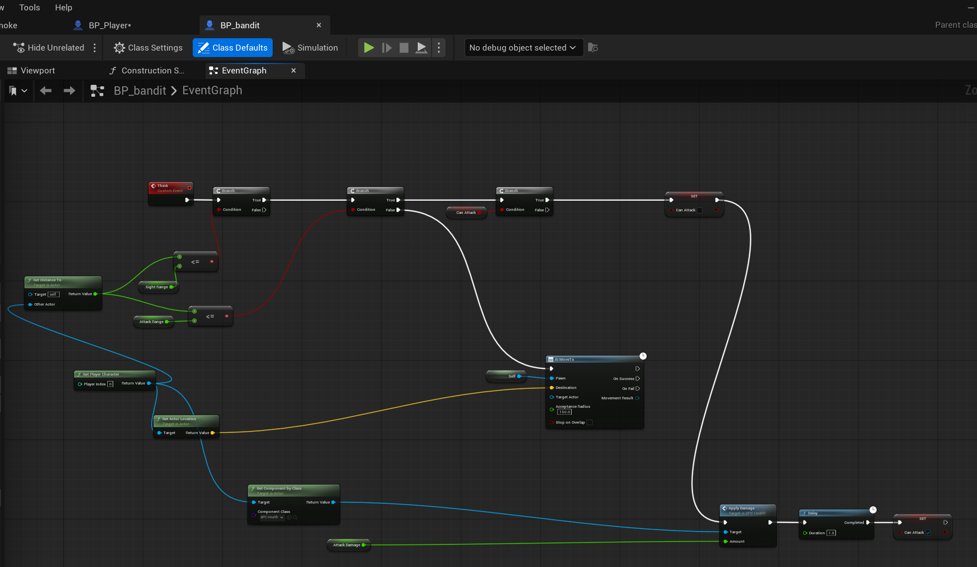
Bandit AI
The bandit measures its distance to the player four times a second and either closes in or attacks.
BP_bandit, Event Graph

Slide 10
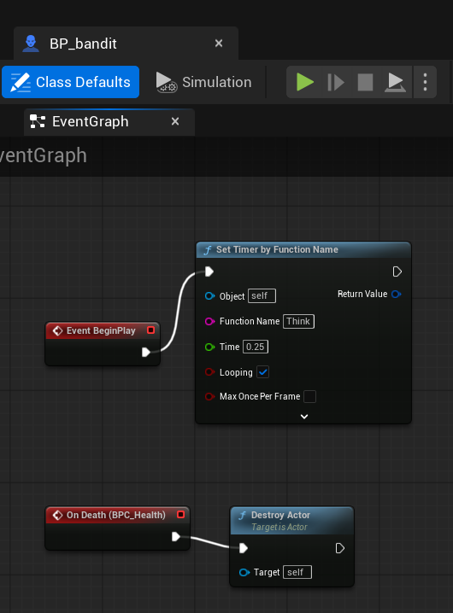
Bandit lifecycle
A looping timer drives the AI, and the health component's death event destroys the actor.
BP_bandit, BeginPlay and death

Slide 11
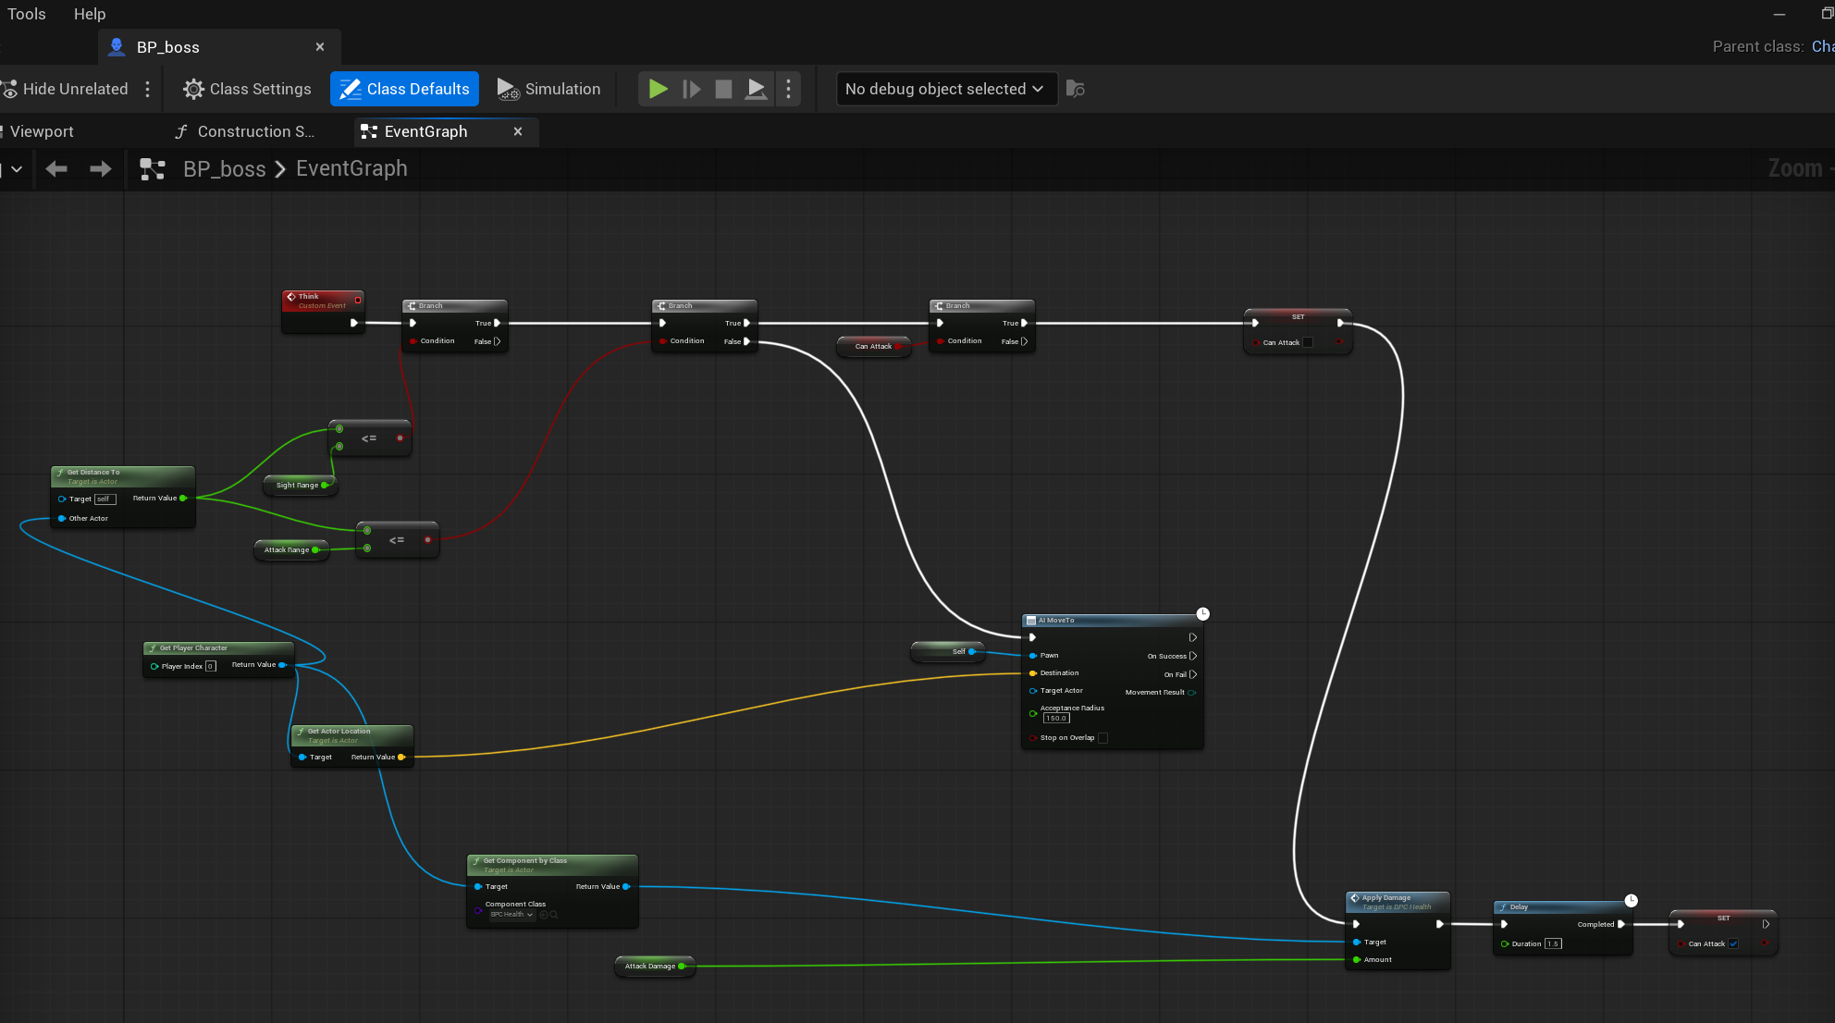
The boss
The boss reuses the bandit's logic with a much larger health pool, slower movement and heavier hits.
BP_boss, Event Graph

Slide 12
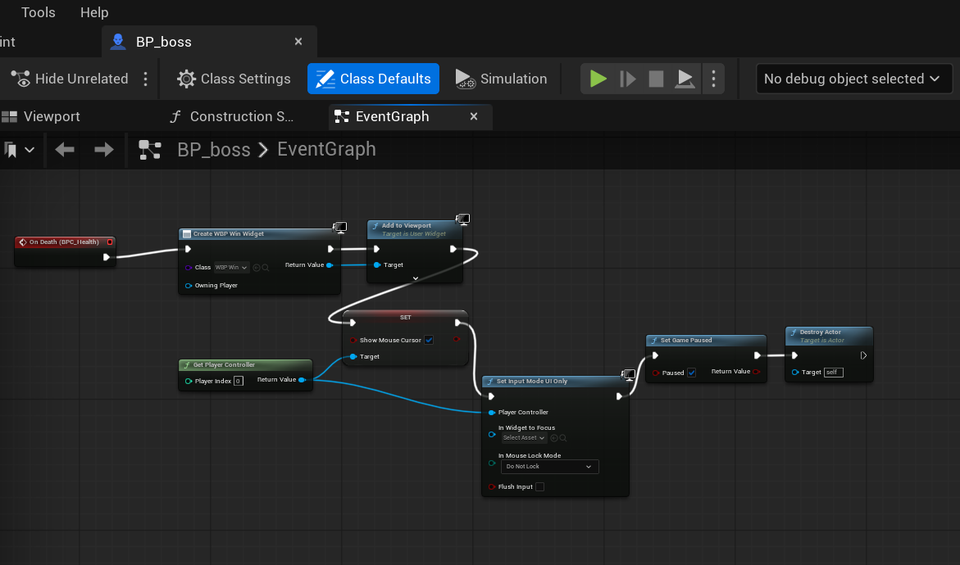
Winning
Killing the boss creates the win widget, pauses the game and hands control back to the mouse.
BP_boss, win condition

Slide 13
Two kinds of powerup
An enumeration keeps the two powerup types readable in the graph instead of using numbers.
E_Powerup

Slide 14
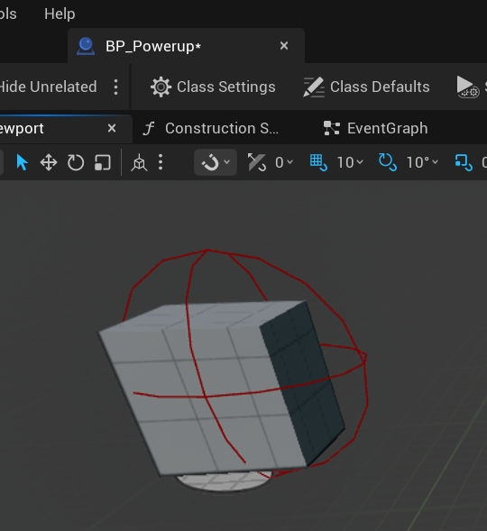
One Blueprint, both powerups
A single actor covers both types, chosen per copy placed in the level.
BP_Powerup, viewport

Slide 15
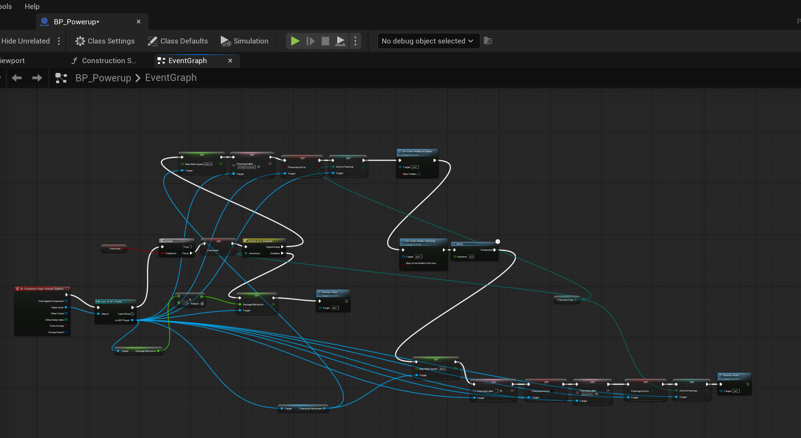
Powerup logic
A switch splits into a timed speed boost that reverts itself, and a permanent damage increase.
BP_Powerup, Event Graph

Slide 16
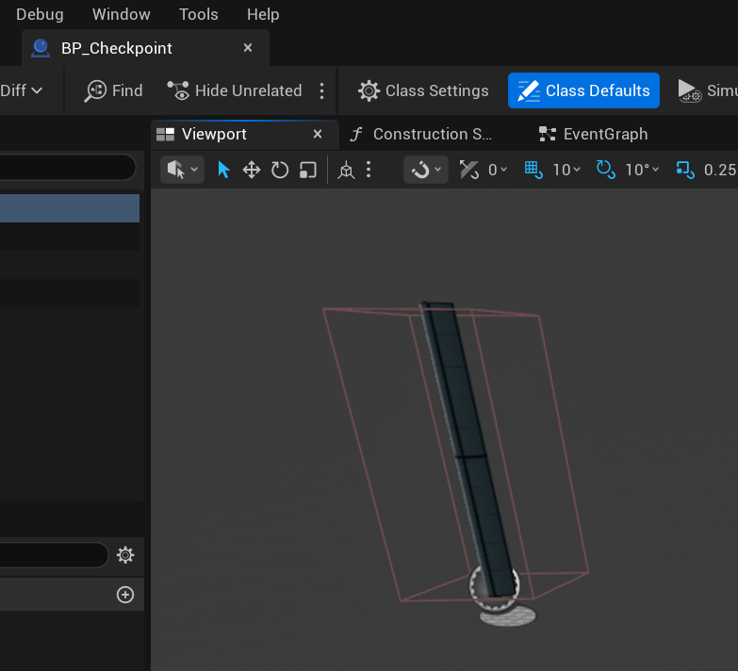
Checkpoints
The checkpoint is a post with a box collision deliberately larger than its mesh, so it is hard to miss.
BP_Checkpoint, viewport

Slide 17
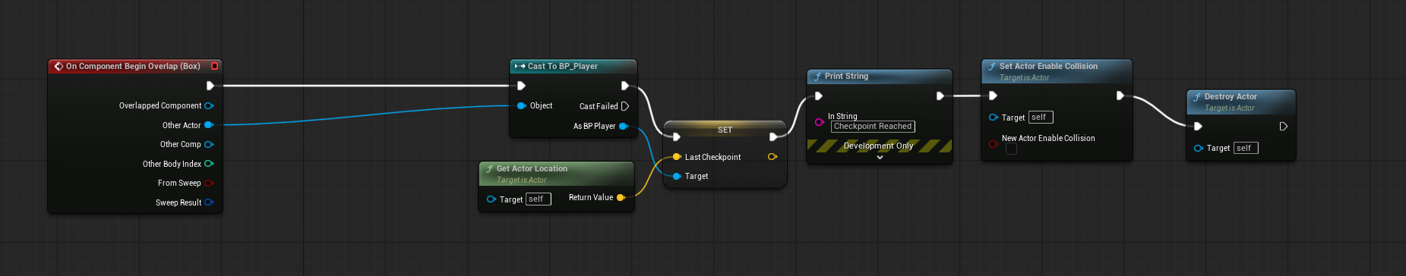
Saving your place
Touching it stores the location on the player and switches off its own collision so it only fires once.
BP_Checkpoint, Event Graph

Slide 18
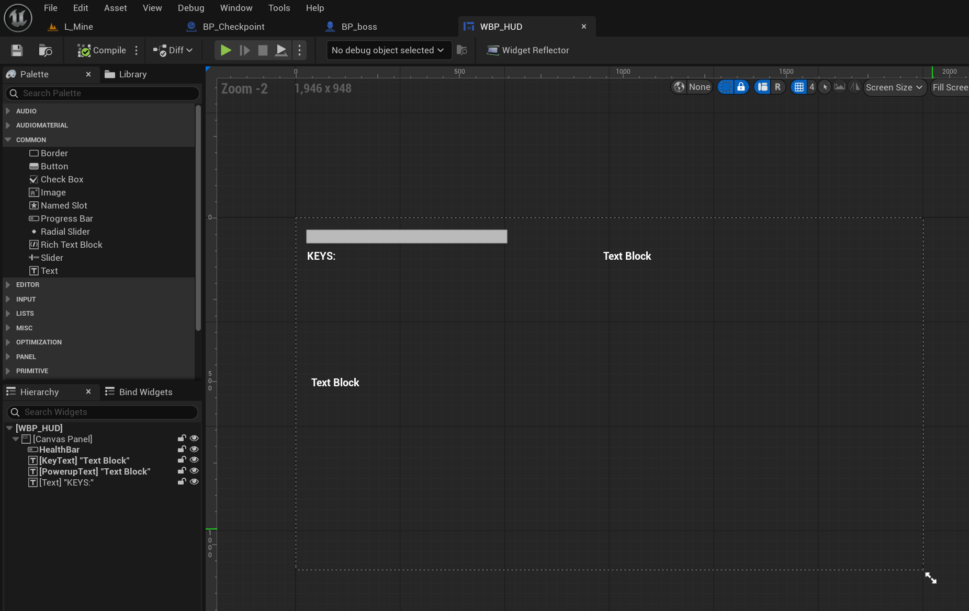
The HUD
The interface is deliberately minimal: a health bar, a key counter and a powerup label.
WBP_HUD, designer

Slide 19
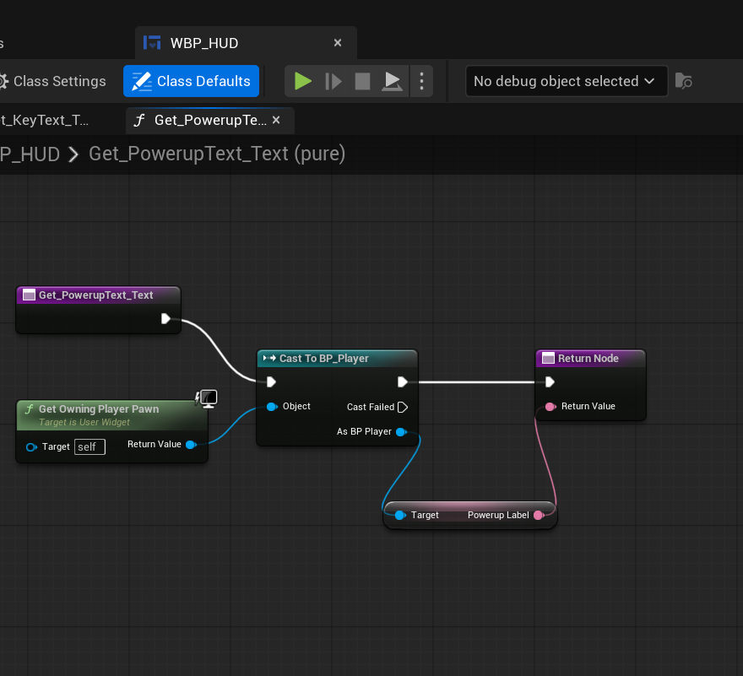
Reading the player
Each HUD element pulls its value from the player through a bound function that runs every frame.
WBP_HUD, text binding

Slide 20
What I learned
Scope first
The design document describes seven weapons and eight powerups. I built one weapon and two powerups, and recorded every cut and the reason for it.
Reuse beats repetition
Writing the health system once as a component meant the player, the bandits and the boss all shared it, and the boss took minutes rather than hours.
Unreal fails quietly
Most bugs produced no error at all. A pawn ignoring the visibility channel, a node defaulting its target to itself, a mesh whose collision was larger than the mesh.
Debugging is a method
Print strings to split a problem in half, collision view to see the invisible, and checking one thing at a time. That mattered more than knowing the engine.

